Slide 1
Software Design Method Health Care Information System
Rui Zhu
Lingjing Huang
Entisar Seedi M Alshammry

Slide 2
Motivation
Improve hospital's cost control
Improve the quality of patient care
Increase the timeliness and accuracy of administration information
Increase service capacity
Reduce personnel costs

Slide 3
Related Work
Best Practices in the Design and Development of Health Care Information Systems (Paper)
OpenEMR. Open source electronic health records and medical practice management solution. http://www.open-emr.org (Website)
Applying UML and Patterns: An Introduction to Object-Oriented Analysis and Design and Iterative Development (Textbook)

Slide 4
What We Choose For The Use Case?
1. Patient admission registration / create patient
2. Medical records - Review / update patient medical records
3. Treatments - Schedule /view / update /cancel treatment / lab
4. Prescribe medication
5. Reorder medication (patient refills / reorders medication)
6. Process medical payment

Slide 5
Use Fully Dressed Template
Primary Actor | Front desk
Stakeholders and Interests: | Doctor: wants patients registered as required; Patient: wants to register to admit the hospital; Front desk: wants to add the patient and his/her treatment to the system without errors; Hospital: wants to accurately record the patient’s and the treatment’s information. Wants to ensure the payment.
Success Guarantee | The front desk receives the confirmation message
Main Success Scenario | System asks user to select the identity type User selects “patient”. System asks for patient’s name and date of birth. The user enters name and date of birth. System searches this information in the patients’ information database. System returns the result and asks user to select the action to take. User selects “register for admission”. System displays the admission registration form. User enters patient ID, department, admission time, room number, bed number, ward number to the system. System searches this information in treatment database and returns the result System adds the new treatment to the treatment database. System display the confirmation message.

Slide 6
Use Fully Dressed Template
Extensions | 6a. In step 6 of the main scenario, system find the patient information does not exist in the database 1. System returns the message that cannot find the patient information in database, and displays the form of patient information 2. User enters the patient’s name, gender, date of birth, address, contact number and insurance information to the system. 3. System creates a new patient information and saves in the database. 11a. In step 11, if the result shows that this treatment already exists in the database. 1. System returns the message that the treatment exists.
Special Requirements

Slide 7
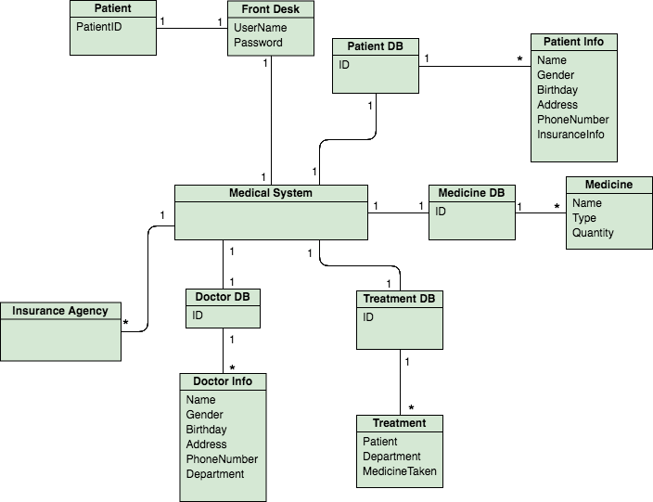
Domain Model

Slide 8
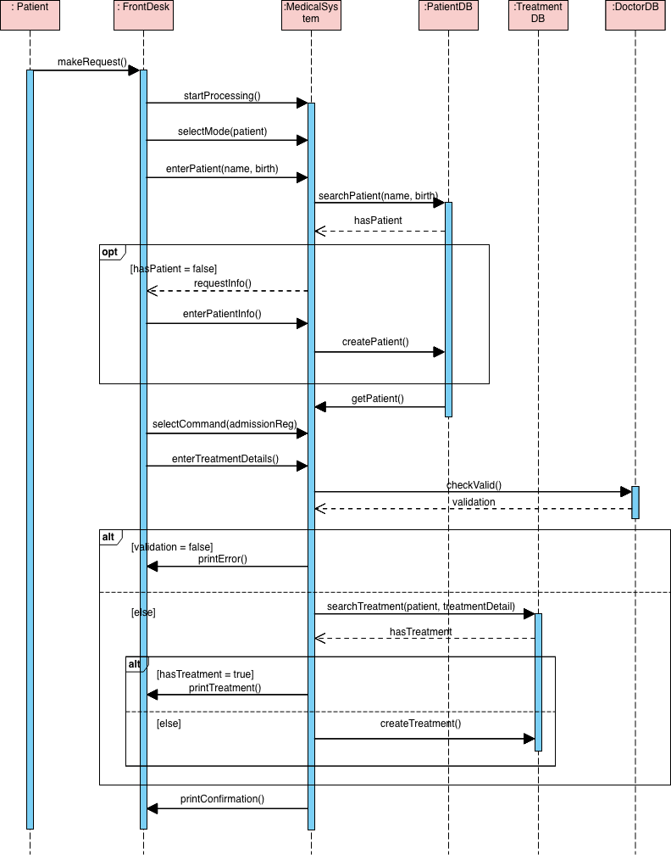
Sequence Diagram

Slide 9
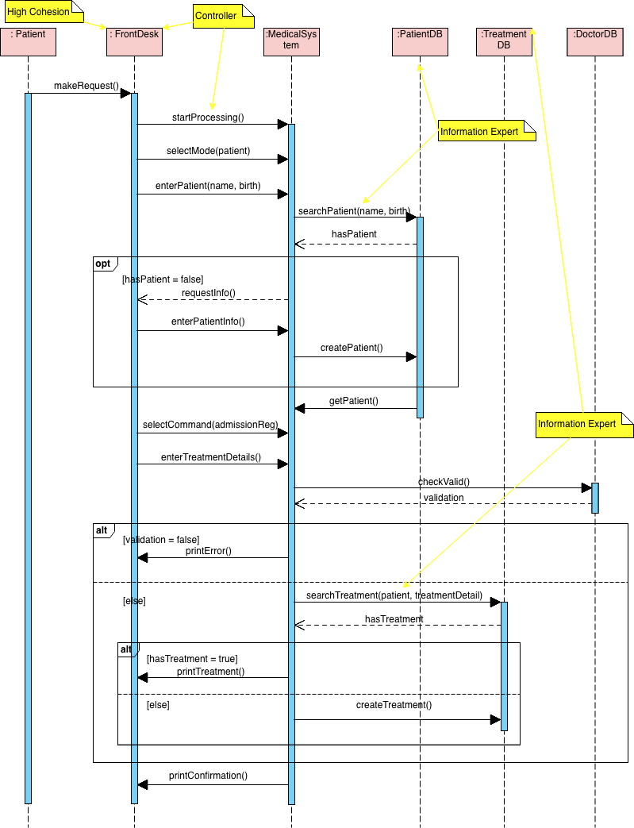
Sequence Diagram and GRASP Principles

Slide 10
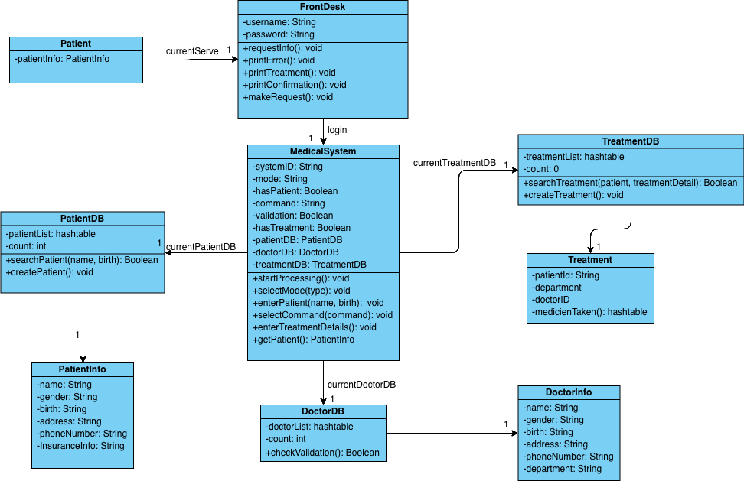
Design Class Diagram

Slide 11
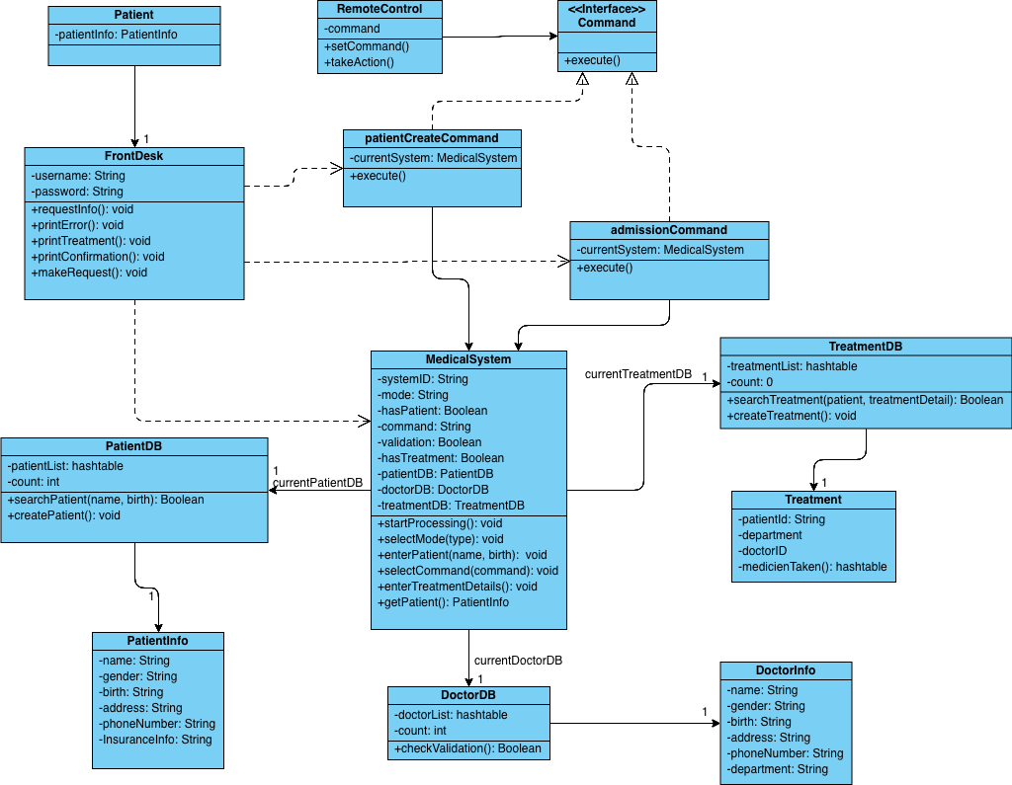
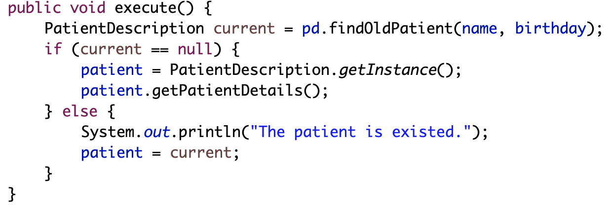
Design Class Diagram

Slide 12
Thank you!

